Slide 1
Cavity Physics

Slide 2
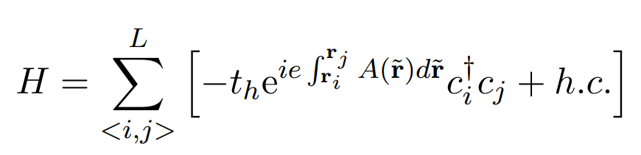
Peierls Substitution :

Slide 3
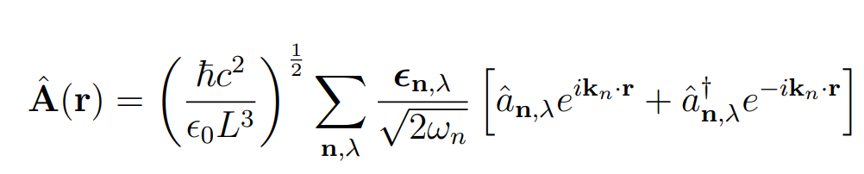
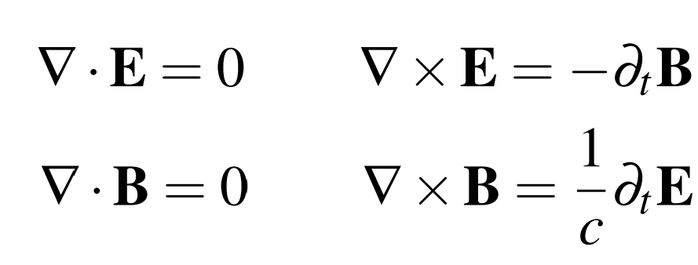
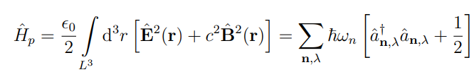
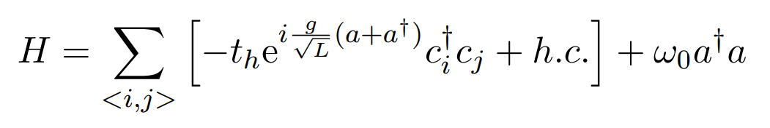
Peierls Substitution :
QUANTIZED LIGHT
LIGHT MATTER COUPLED MODEL

Slide 4
Peierls Substitution :
QUANTIZED LIGHT
LIGHT MATTER COUPLED MODEL

Slide 5

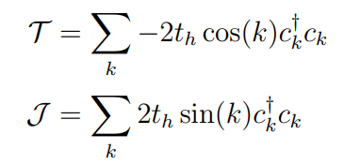
In momentum space :

Slide 6
In momentum space :
$$\left|ψ\right\rangle ={\left|φ\right\rangle }_{cav}⊗|φ\left(λ\right)⟩$$
Factorizable Eigenstates :

Slide 7

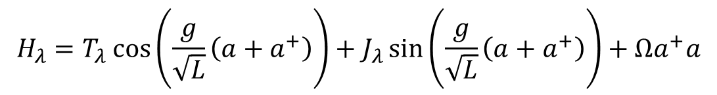

In momentum space :
$$\left|ψ\right\rangle ={\left|φ\right\rangle }_{cav}⊗|φ\left(λ\right)⟩$$
Factorizable Eigenstates :
Variational scheme to find the ground state
$$H_{λ}=T_{λ}\cos\left(\frac{g}{\sqrt{L}}\left(a+a^{+}\right)\right)+J_{λ}\sin\left(\frac{g}{\sqrt{L}}\left(a+a^{+}\right)\right)+Ωa^{+}a$$
$$λ$$

Slide 8
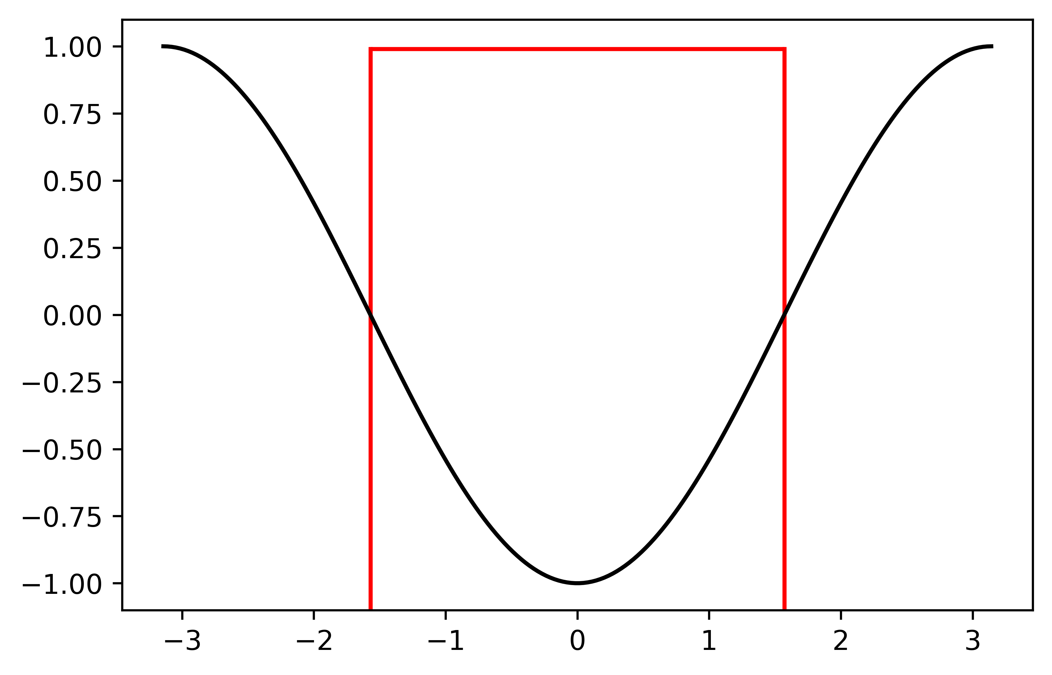
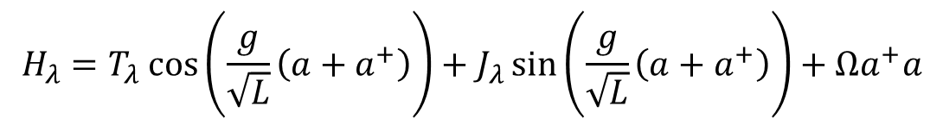
In momentum space :
Factorizable Eigenstates :
$$\left|ψ\right\rangle ={\left|φ\right\rangle }_{cav}⊗|φ\left(λ\right)⟩$$
Integrable System:
TASK
$$H_{λ}=T_{λ}\cos\left(\frac{g}{\sqrt{L}}\left(a+a^{+}\right)\right)+J_{λ}\sin\left(\frac{g}{\sqrt{L}}\left(a+a^{+}\right)\right)+Ωa^{+}a$$

Slide 9
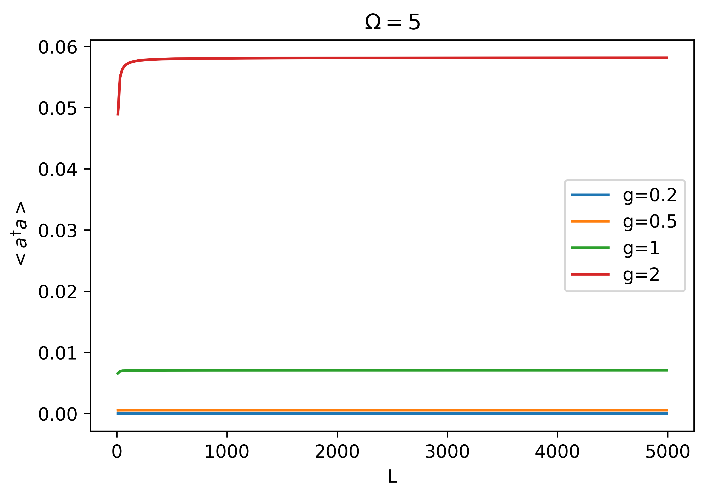
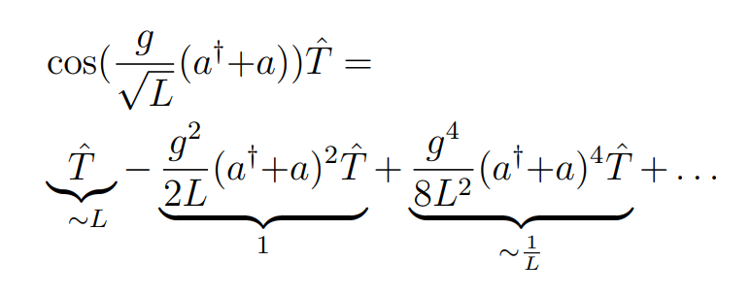
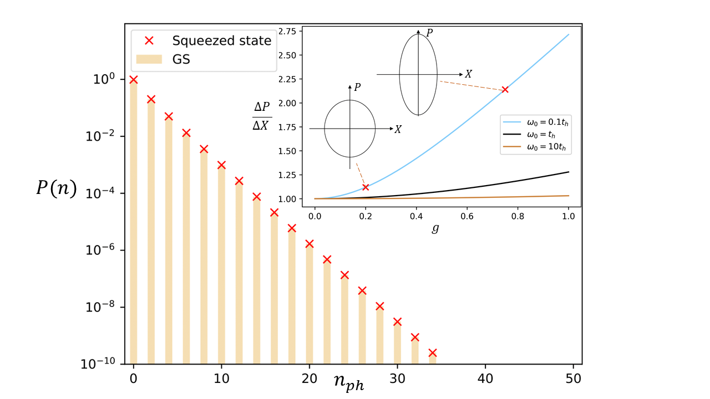
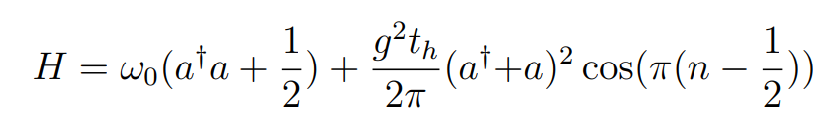

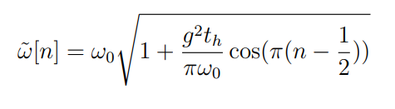

Thermodynamic limit
$$L →∞$$
Exactly solved by Squeezed-state:

Slide 10
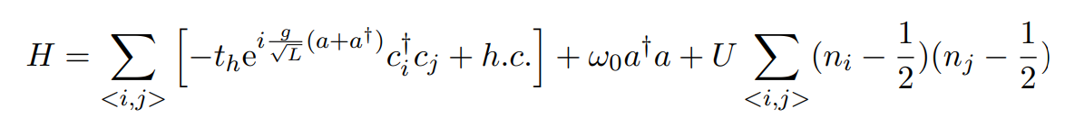
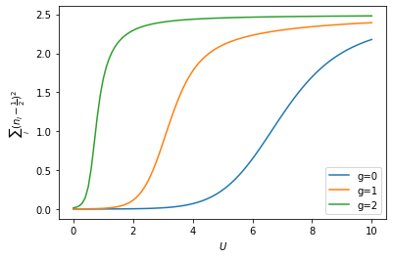
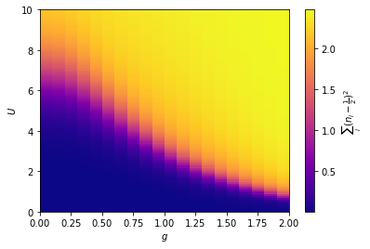

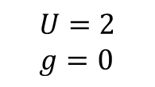
Adding interactions :
Luttinger liquid
Charge Density wave
$$U=2$$
$g=0$
$$U$$
Inifinite order phase transition

Slide 11
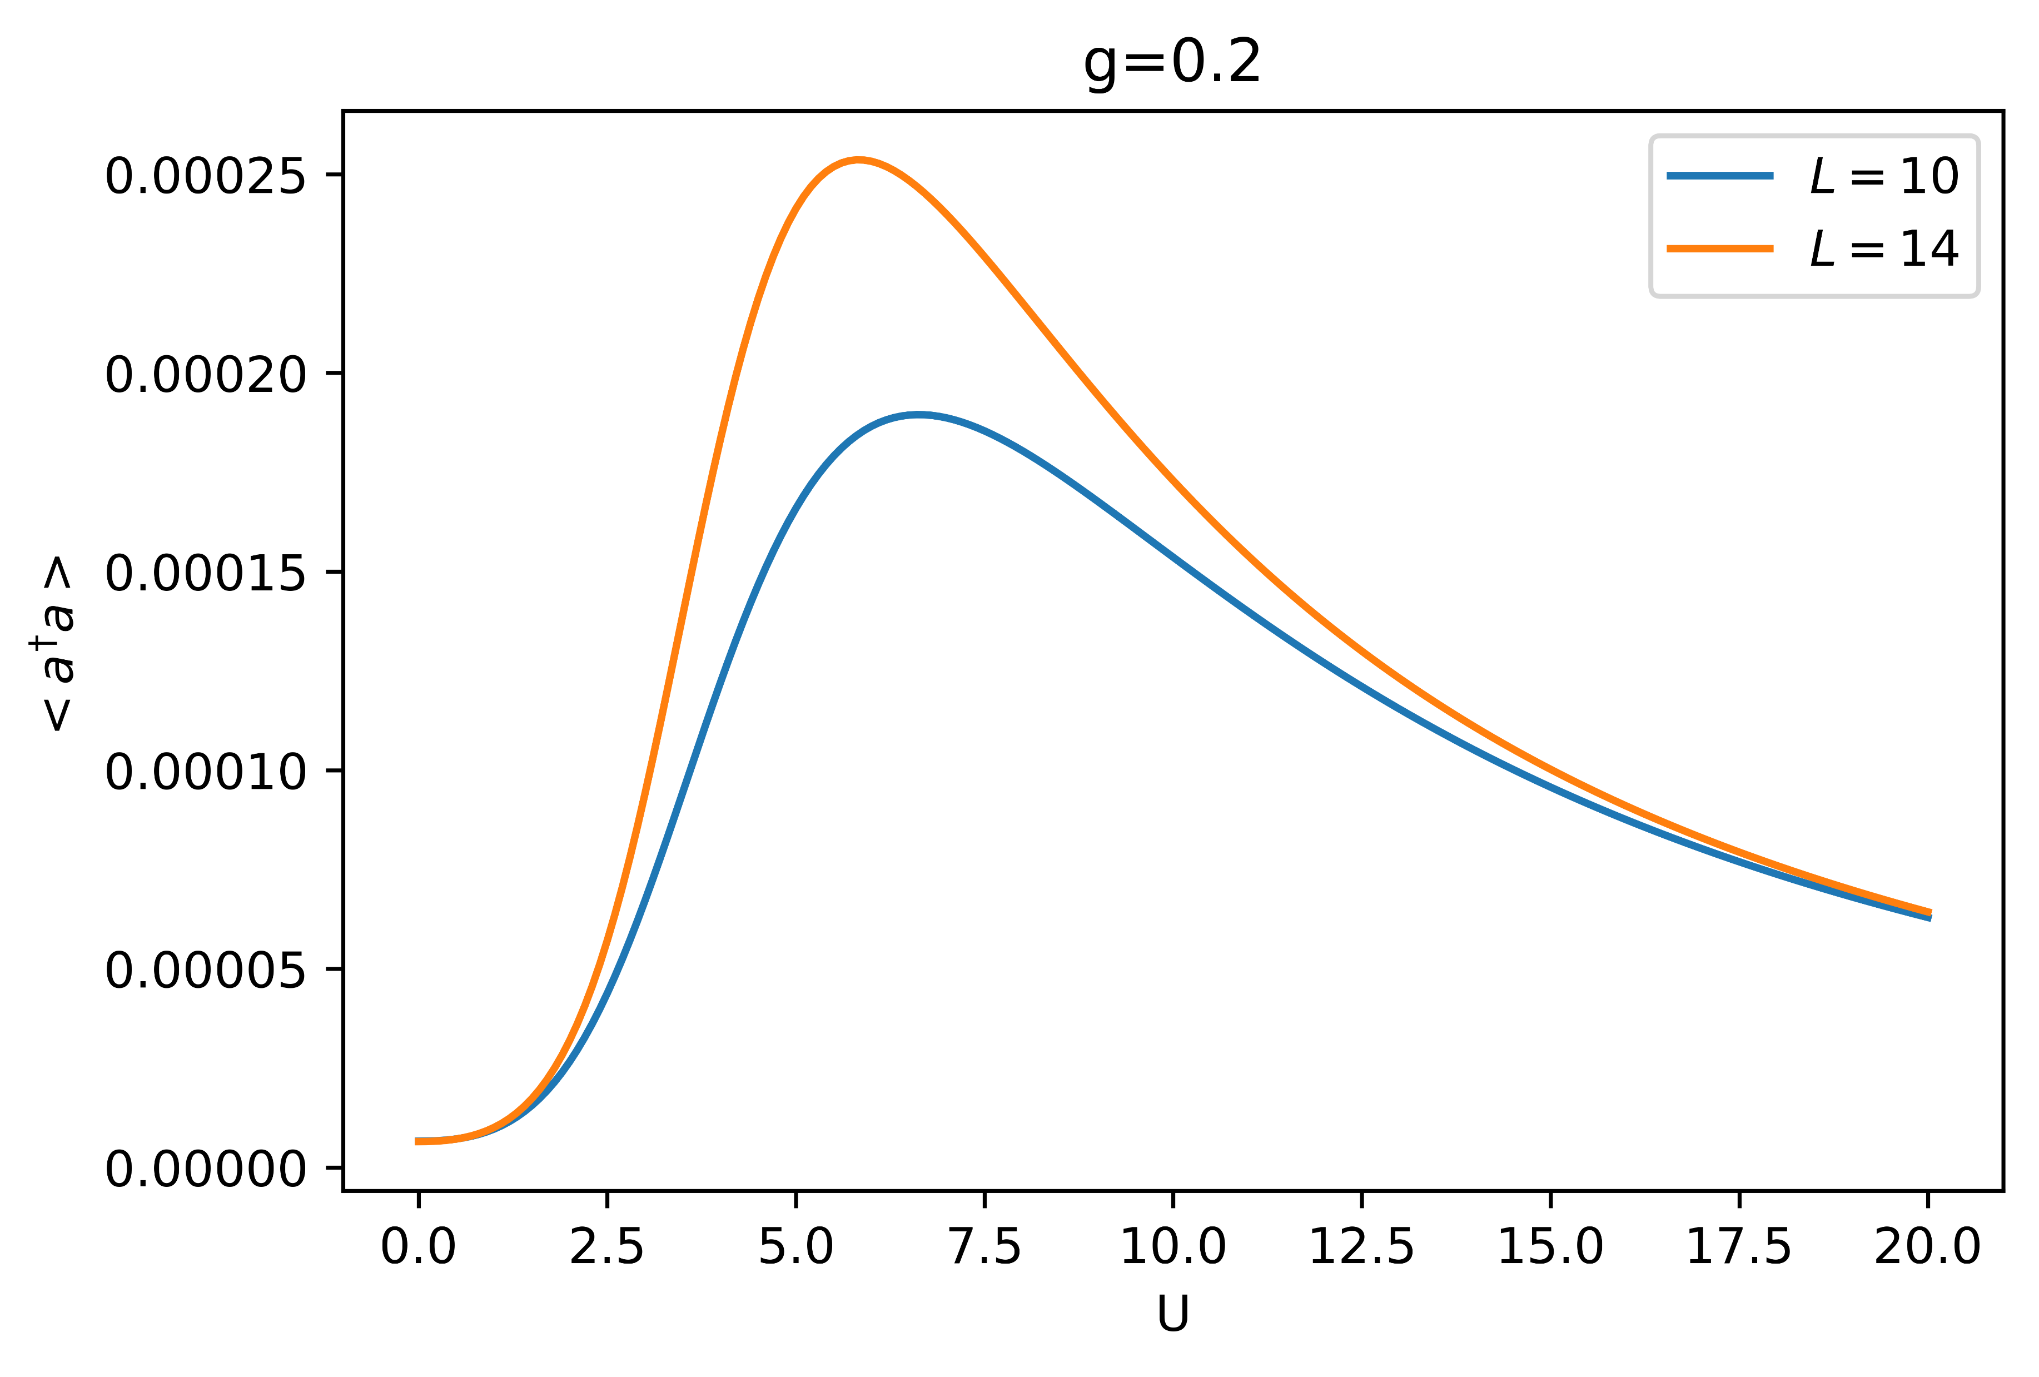
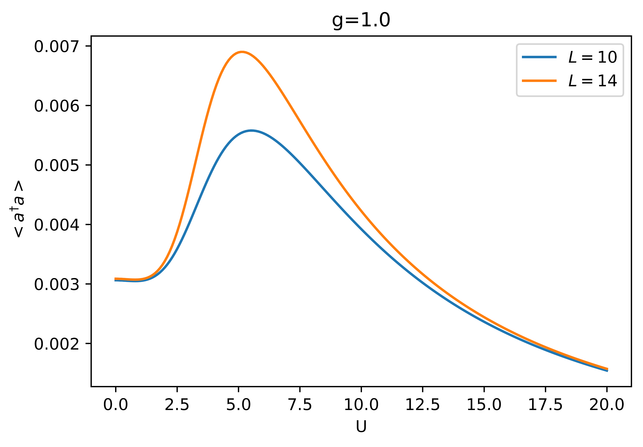
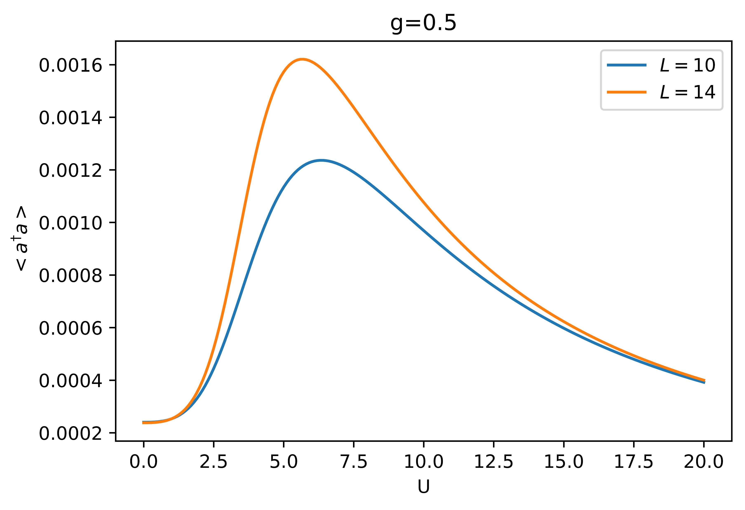

Slide 12
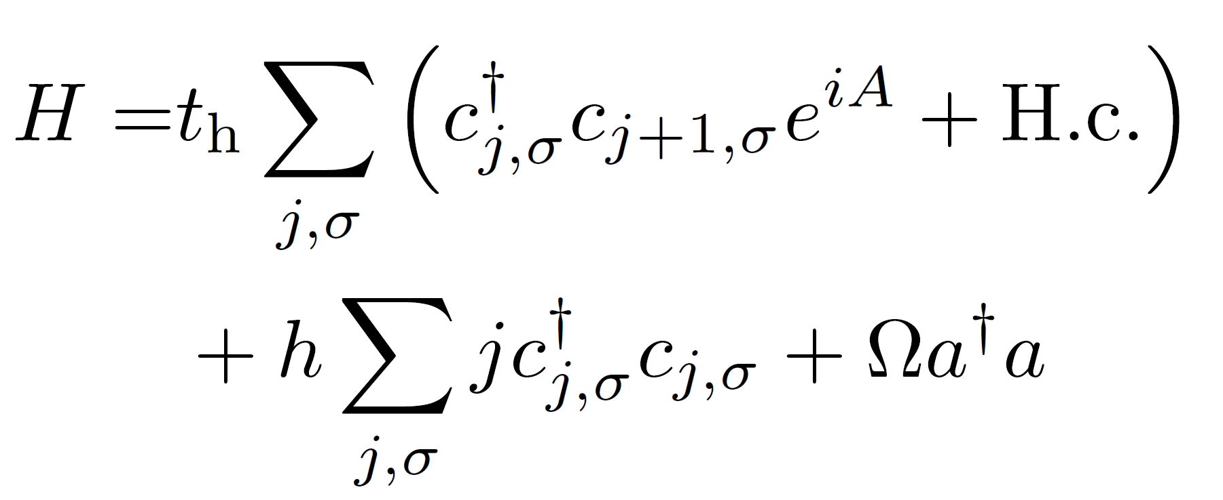
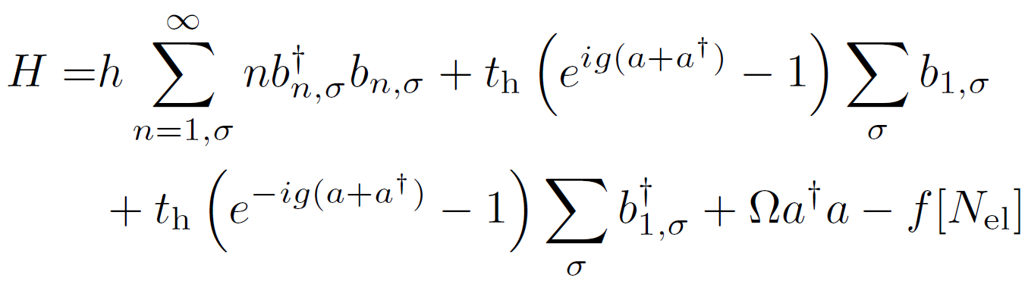
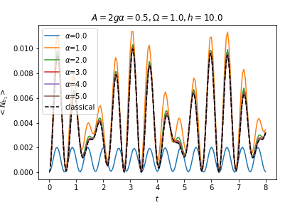
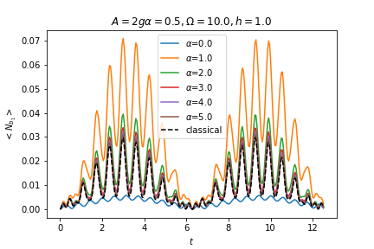
Wannier-Stark Model in a Cavity:
Bosonization

Slide 14
Outlook

Slide 15
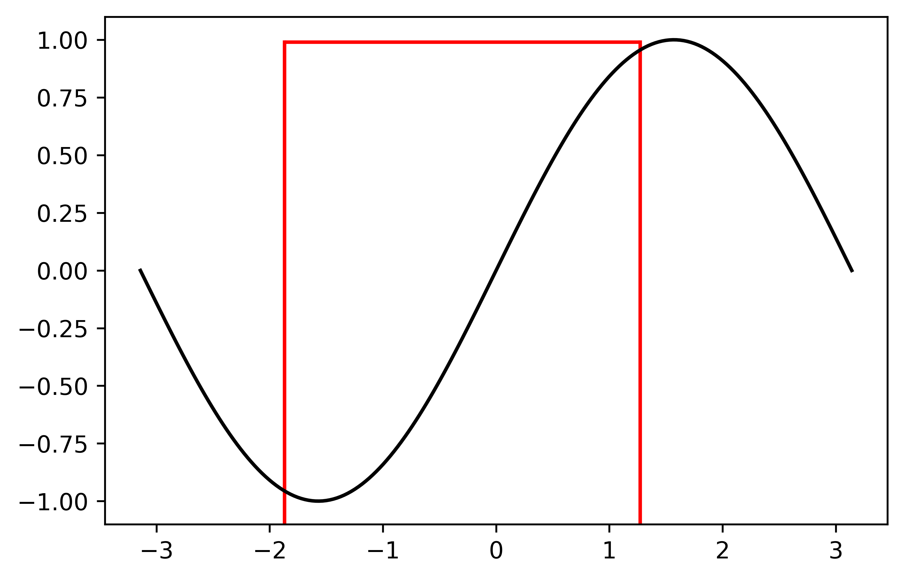
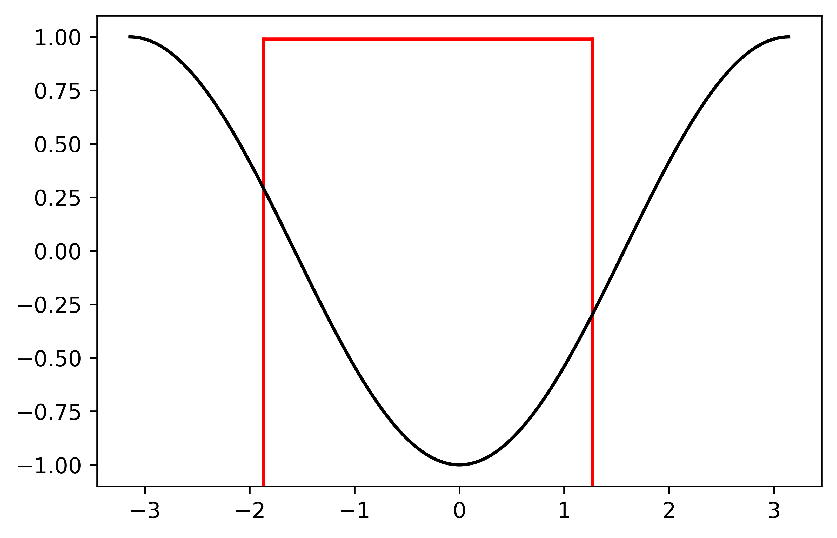





Ground-state
Variational Scheme :
Minimize: $H=T_{λ}\cos\left(\frac{g}{\sqrt{L}}\left(a+a^{+}\right)\right)+J_{λ}\sin\left(\frac{g}{\sqrt{L}}\left(a+a^{+}\right)\right)+Ωa^{+}a$
$$λ$$
$$λ$$
$$T_{λ}$$
$$J_{λ}$$
Unshifted Fermi sea:

Slide 16

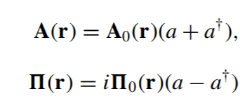


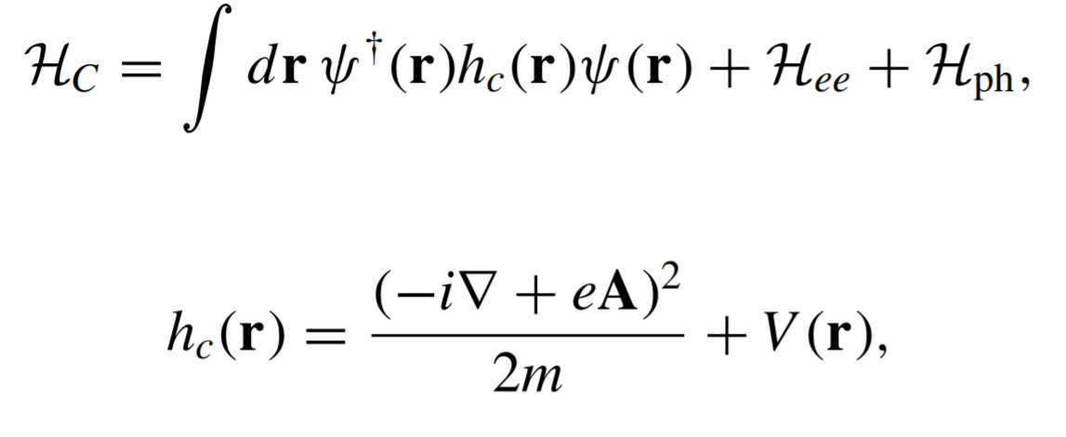

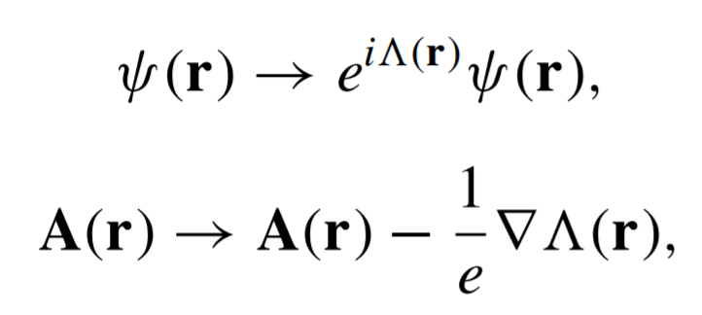

Coupling light-matter in the continuum:
Quantized EM field (Single mode)
Electronic hamiltonian in the continuum :
$$H_{el}=H_{0}+H_{ee}$$
Minimal coupling scheme (canonical substitution) :
This construction scheme automatically implements
Gauge invariance, given by :

Slide 17
Coupling light-matter in the continuum:
Quantized EM field (Single mode)
Electronic hamiltonian in the continuum :
$$H_{el}=H_{0}+H_{ee}$$
Minimal coupling scheme (canonical substitution) :
This construction scheme automatically implements
Gauge invariance, given by :

Slide 18
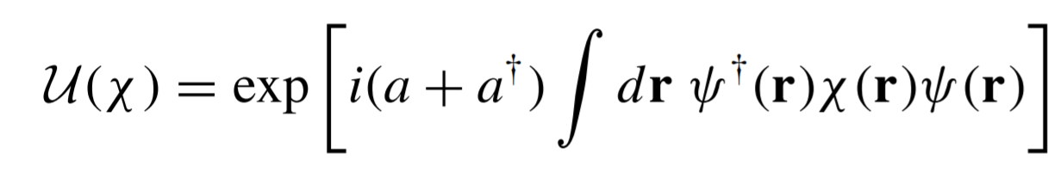



The canonical replacement of the conjugate momentum can be also be seen as the application of a
Unitary operator :
That allows to get back the same coulomb gauge projected hamiltonian as :
As we are going to see this allows to implement a gauge consistent scheme to build low-energy
Project models with light-matter interaction.

Slide 19

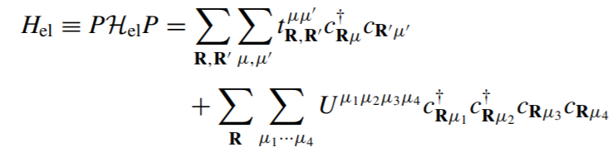

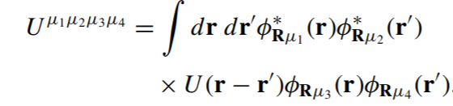
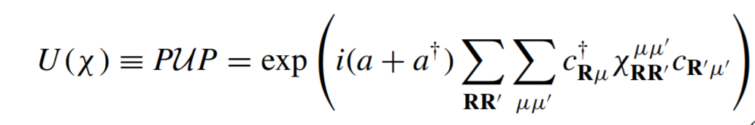
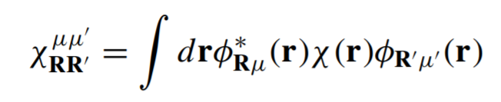
How to get the model from a low energy projection of a strong interacting model
Tight-binding approach:
With :
And
We want now to include the interaction with the EM field, a possible approach is to project the unitary transformation
That realizes the minimal coupling substitution IN the set of low energy states :
It’s important to stress that this it’s just a possible
Way to implement the LM coupling.
On top of it there is the fact that tigh binding models
Are already an approximation, this procedure as the
Advantage to preserve the gauge structure in this
Low energy approximations.
Also notice that what we will call «g» will depend on the form
Of the wannier basis

Slide 20
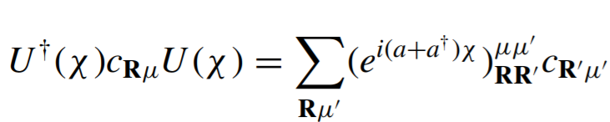
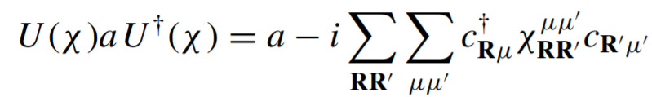

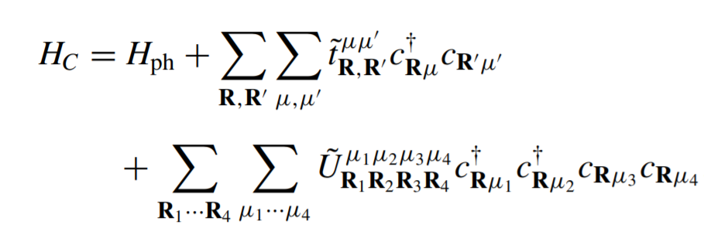
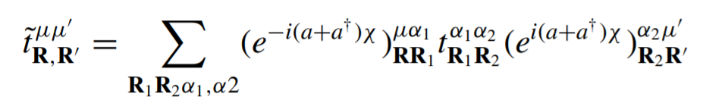
Resume : Starting from the definition of an unitary operator that realizes the light matter coupling in the continuum
Theory, the approach is to project it in the wannier-basis, getting a projected unitary operator that defines a dressing
Of the creation-annihilation operators:
While the photonic degrees of freedom get shifted
Finally one get the projected model as:
And in particular:
With

Slide 21

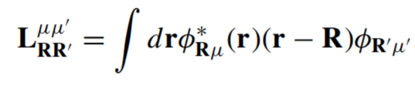

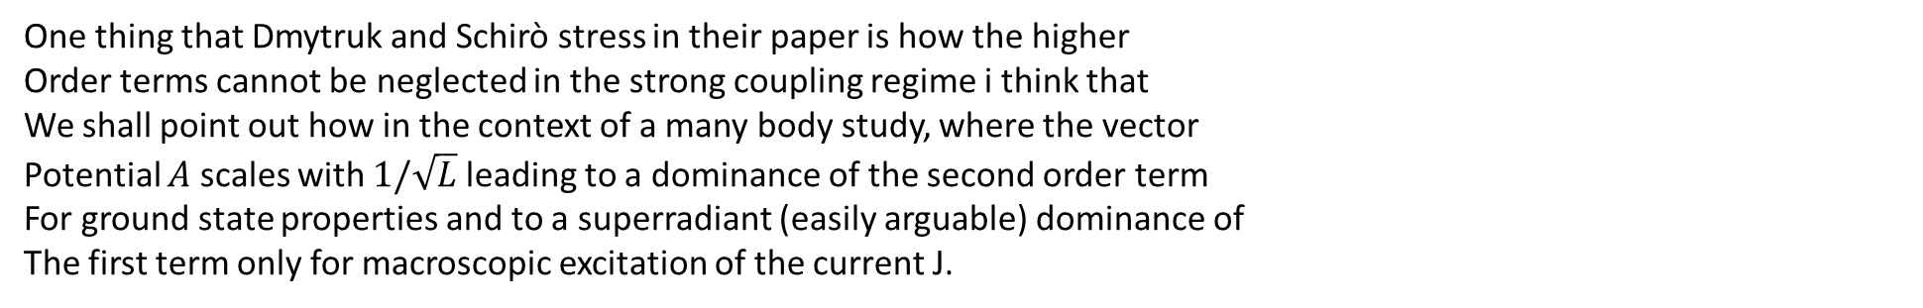
One thing that Dmytruk and Schirò stress in their paper is how the higher
Order terms cannot be neglected in the strong coupling regime i think that
We shall point out how in the context of a many body study, where the vector
Potential $A$ scales with $1/\sqrt{L}$ leading to a dominance of the second order term
For ground state properties and to a superradiant (easily arguable) dominance of
The first term only for macroscopic excitation of the current J.
To close the derivation of the Peierls dressing:
In the dipole approximation its possible to expand $χ$ around the orbitals centers
Neglecting this term
Which gives exactly the Peierls term
Sidemark: starting from the first definitions it’s possible to construct the g factor.

Slide 22

Gauge Equivalence:
Even if for the moment i have not included it, it is possible to show that in the same way
You can build the lattice projection of the dipolar gauge, nominally realized by an unitary operator T.
The argument in favour of this projected gaugie theories is that it’s possible to show that different gauge projected
Are «equivalent» in the sense that they are related by a unitary transformation. In fact the relation between the Coulomb
Gauge and the Dipolar Gauge reads :
What is not fully clear to me is how they dimonstrated that this holds for any arbitrary gauge other than the dipolar
and the coulomb.

